Slide 1

Women Safety
Smart SOS System

Slide 2
Introduction
This project focuses on a Women Safety Website enabling instant help through a one-click SOS alert system. It leverages real-time location tracking and cloud technologies to ensure quick response from emergency contacts and police stations. The aim is to enhance security and reduce response time in critical situations by combining web and geolocation technologies.

Slide 3

01
Project Concept

Slide 4
Purpose and Aim
The main objective is to provide instant assistance to women in emergency situations by sharing their live location with trusted contacts and authorities. This system ensures safety by enabling quick identification and response, fostering a secure environment through modern web and cloud technologies.

Slide 5
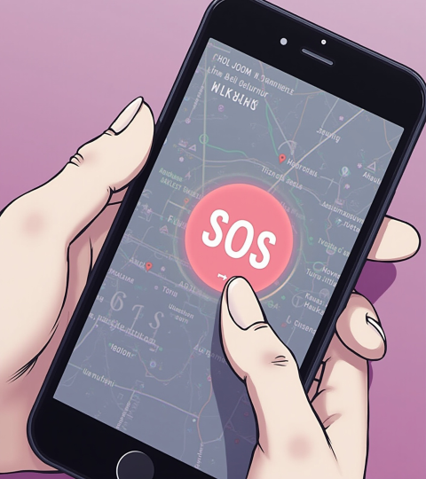
Core Features Overview
Key features include a single-click SOS button, automatic and manual location selection, live movement tracking, and instant alerts to emergency contacts and nearby police stations. The system also uses Firebase for real-time data handling and secure user authentication to maintain privacy and efficiency.

Slide 6
Technologies Used
The system employs HTML, CSS, and JavaScript for a responsive frontend experience. It integrates Google Maps and Geolocation APIs for precise location tracking. The backend uses Firebase Realtime Database and Authentication to manage user data securely. Additionally, messaging APIs such as WhatsApp and SMS are utilized for instant emergency notifications.

Slide 7

02
System Architecture

Slide 8
User Interaction Flow
Users start by registering their details and emergency contacts on the website. Location can be detected automatically or selected manually. When the SOS button is pressed, the system sends alerts immediately to contacts and police stations, with live location updates if the user moves, ensuring continuous tracking during an emergency.

Slide 9

Emergency Alert Process
Upon activation, the SOS button triggers an instant alert containing the user’s name, mobile number, and live Google Maps location. This alert is sent to multiple emergency contacts and the nearest police station. The system continuously updates the location in real time, allowing responders to track movements until the situation is resolved.

Slide 10
Data Management and Security
User data and live locations are stored in Firebase Realtime Database, ensuring instant updates without refresh delays. The system uses Firebase Authentication to provide secure login and restricts location sharing strictly to emergency situations. User privacy is prioritized with controlled data access to prevent unauthorized usage.

Slide 11
Conclusions
The Women Safety system offers a robust and reliable platform for instant emergency response through live location tracking and real-time alerts. By connecting users with trusted contacts and law enforcement swiftly, the solution enhances personal safety and response efficiency, leveraging modern web and cloud technologies for social impact.

Slide 12
Thank you

